Slide 1


Introduction to Comprehensive Railway Intelligent Safety System (CRISS)
CRISS is a cutting-edge system that integrates advanced sensors, real-time monitoring, and predictive analytics to enhance safety and efficiency across railway networks. This comprehensive solution aims to revolutionize the way railways operate, ensuring the well-being of passengers and the integrity of critical infrastructure.

Slide 2
Motivation Behind the CRIS System
The Comprehensive Railway Intelligent Safety System (CRISS) is born out of a pressing need to prevent tragic accidents involving vehicles falling from overbridges and boulders falling from the mountains onto railway tracks. These accidents have claimed numerous lives and caused extensive damage to property, underscoring the urgency and importance of developing a proactive safety solution.
Car Falls off ROB, Several Trains Delayed (Times of India)
Landslide, Heavy Rain Led to Duronto Derailment: Railways (Times of India)
24 Dead, 60 Injured in Rail Mishap as Engine Hits Boulder Near Mumbai
9 Killed, Over 40 Injured as Bengaluru-Ernakulam Express Derails Near Hosur (The Indian Express)

Slide 3
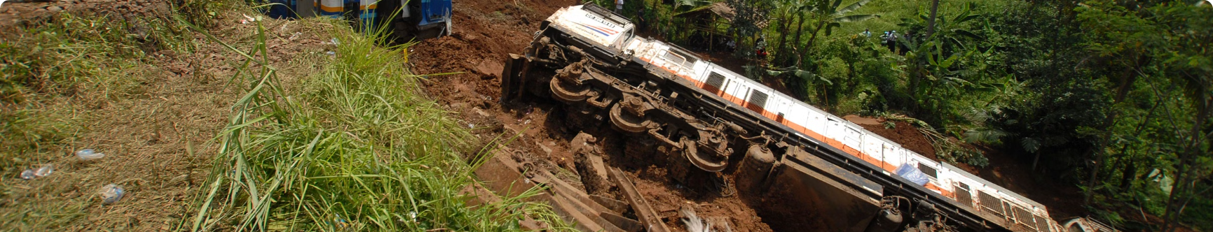
The Issue and Challenges:
Accidents involving objects falling onto railway tracks have tragically claimed many lives worldwide. These incidents are often the result of driver errors of road vehicles, structural issues with overbridges, or unforeseen circumstances. The challenges associated with preventing such accidents include the need for real-time detection, rapid communication, and prompt action to shut down traffic and traction in affected sections. Traditional safety measures may not provide the speed and effectiveness required to prevent these catastrophic events.

Slide 4

Objectives and Scope of CRISS
Enhancing Railway Safety through Proactive Detection and Prevention:
Design and develop a FOD system capable of real-time detection of objects falling onto railway tracks, including:
Vehicles from road over-bridges, Rocks from mountain cuttings, Landslides, Miscellaneous objects posing safety hazards
Implement automated warning & intervention protocols upon object detection to:
Alert train operators & infrastructure control centres
Shutdown power/ traction in affected area
Turn on red aspect signal to restrict trains entering the affected section
Initiate emergency braking procedures
Reduce the risk of collisions and derailments caused by falling objects
Optimizing Detection Accuracy and System Robustness:
Analyse diverse object types and falling scenarios to develop comprehensive detection algorithms
Implement robust data processing and filtering techniques to minimize false positives and ensure system stability

Slide 5

Objectives and Scope of CRISS
Optimizing Detection Accuracy and System Robustness:
Analyse diverse object types and falling scenarios to develop comprehensive detection algorithms
Implement robust data processing and filtering techniques to minimize false positives and ensure system stability
Integration and Interoperability with Existing Railway Systems:
Develop seamless integration with existing train control and communication systems
Ensure compatibility and interoperability with standard railway safety protocols
Design user-friendly interfaces for efficient monitoring and control of the FOD system
Cost-Effectiveness and Sustainability:
Optimize system design to be cost-effective and commercially viable for widespread implementation
Utilize energy-efficient hardware and software to minimize operational costs and environmental impact
Develop sustainable maintenance and upgrade strategies for long-term system performance

Slide 6
Key Components of CRISS
Phase 1: Falling Object Detection System:
Phase 2: Landslide Prediction and Detection System:
The Falling Object Detection System aims to identify heavy objects falling onto railway tracks & prevent potential collisions.
Phase 2 focuses on enhancing railway safety by predicting and detecting landslides along railway routes.
It utilizes force-resistive sensors positioned strategically at tunnel portals and bridges to detect impacts.
A simulated machine learning model has been developed to predict the likelihood of landslides.
The prototype employs Arduino microcontrollers to analyze sensor data and initiate actions. SMS alerts are sent using GSM modules to notify relevant personnel.
The ensemble model incorporates GBM, LGBM, XGBoost, and random forest methods.
Features such as Aspect, Curvature, Earthquake, Elevation, Flow, Lithology, NDVI, NDWI, Plan, Precipitation, Profile, and Slope are used to predict landslides.

Slide 7
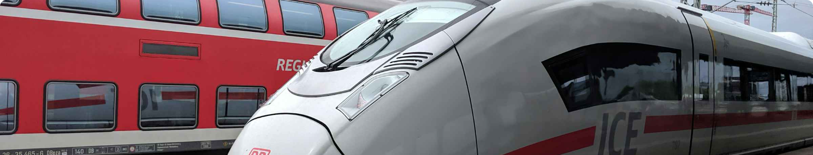
Key Components of CRISS
Upon detection or prediction of a potential landslide, the system triggers several actions:
Sends alert messages to railway authorities.
Switches off traction power supply in the affected track section.
Automatically turns signals red to prevent trains from entering the hazardous section.

Slide 8
Data Collection & Analysis for Phase 1: Falling Object Detection System
1
Vehicle types examined:
2
Parameters considered:
3
Purpose of analysis:
Weight, speed, and impact surface area
To program our system to trigger alerts based on specific impact thresholds and design our wire fencing accordingly
Various vehicle types traversing Indian roadways

Slide 9
Analysis of Minimum Impact
We conducted an analysis to determine the potential impact of the lightest vehicle in our study, the TVS Scooty Pep+. This vehicle weighs 93 kg, and we assumed it may be running at a speed of 20 km/h (5.56 m/s), which is considered the least speed scenario falling onto the net.
Given Parameters:
Mass of the scooter (m): 93 kg
Speed of the scooter (v): 20 km/h (converted to meters per second: (5.56 (m/s))
Assumed collision distance (d): 0.5 m (depth of the net)
Calculating Kinetic Energy (KE):
Kinetic energy (KE) is calculated using the formula: KE = \frac{1}{2} \times m \times v^2
Substituting the given values: KE = \frac{1}{2} \times 93 \times (5.56)^2
KE \approx 1447.016 , \text{Joules}
Calculating Impact Force (Using Impulse):
Calculating the change in momentum ( \Delta p ): \Delta p = m \times v

Slide 10
Analysis of Minimum Impact
\Delta p = 93 \times 5.56
\Delta p \approx 515.28 , \text{kg m/s}
Average impact force (F_{avg}): F_{avg} = \frac{\Delta p}{d}
F_{avg} = \frac{515.28}{0.5}
F_{avg} \approx 1030.56 , \text{Newtons (N)}
Peak impact force (F_{peak}): F_{peak} = 2 \times F_{avg}
F_{peak} = 2 \times 1030.56
F_{peak} \approx 2061.12 , \text{Newtons (N)}
Therefore, for the scooter with a speed of 20 km/h, the calculated average impact force is approximately 1030.56 N, and the peak impact force is approximately 2061.12 N.
We have equated the approximate impact force of 1030 N with value of 800 of our FSR

Slide 11
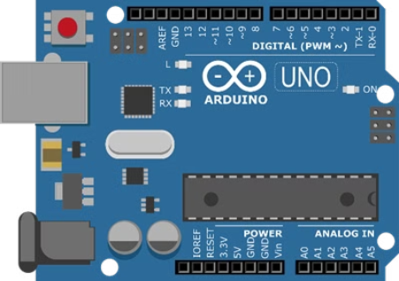
System Architecture of FOD System
Arduino Uno:
Arduino Uno is a microcontroller board, developed by Arduino.cc, based on the Atmega328 microcontroller and is marked as the first Arduino board developed (UNO means "one" in Italian). It can be programmed using the Arduino Software (IDE) to perform various tasks such as blinking LEDs, reading sensors, controlling motors, etc. It has 14 digital input/output pins, 6 analog inputs, a USB connection, a power jack, a reset button, and an ICSP header.

Slide 12

System Architecture of FOD System
Force Resistance Sensor (FSR):
Force Resistance Sensor (FSR) is a material whose resistance changes when a force, pressure or mechanical stress is applied. They are also known as force-sensitive resistor and are sometimes referred to by the initialism FSR. ³ FSRs consist of a conductive polymer, which predictably changes resistance following applying force to its surface. They are normally supplied as a polymer sheet or ink that can be applied by screen printing. The sensing film consists of electrically conducting and non-conducting particles suspended in a matrix. Applying a force to the surface of the sensing film causes particles to touch the conducting electrodes, changing the film's resistance.

Slide 13
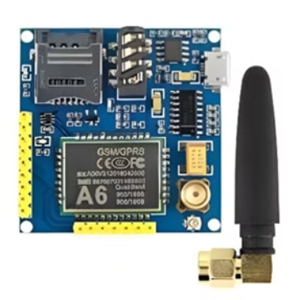
System Architecture of FOD System
GSM Module:
GSM module or a GPRS module is a chip or circuit that use to establish communication between a mobile device or a computing machine and a GSM or GPRS system. GSM is a standard for digital cellular communications, which means that it provides a platform for mobile devices to communicate with each other wirelessly. GPRS is a packet-oriented mobile data service on the GSM network, which allows data transmission at higher speeds than GSM. A GSM module or a GPRS module requires a SIM card to activate communication with the network. It can be used to send and receive SMS, make, and receive calls, access the internet, and perform other wireless functions.

Slide 14
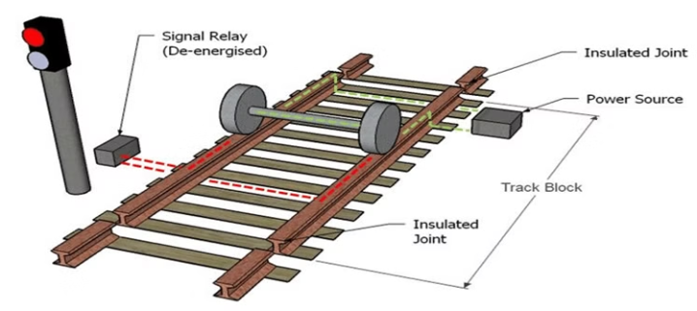
System Architecture of FOD System
Rail Track equipped with Track Circuit:
Rail Track equipped with Track Circuit is an electrical device used to detect the presence or absence of trains on a railway track and to control signalling and block equipment accordingly. A track circuit typically has power applied to each rail and a relay coil wired across them. When no train is present, the relay is energised by the current flowing from the power source through the rails.
When a train is present, its axles short the rails together, reducing the current to the relay coil and de-energizing it. Circuits through the relay contacts therefore report whether the track is occupied. Track circuits allow railway signaling systems to operate semi-automatically, by displaying signals for trains to slow or stop in the presence of occupied track ahead of them.

Slide 15
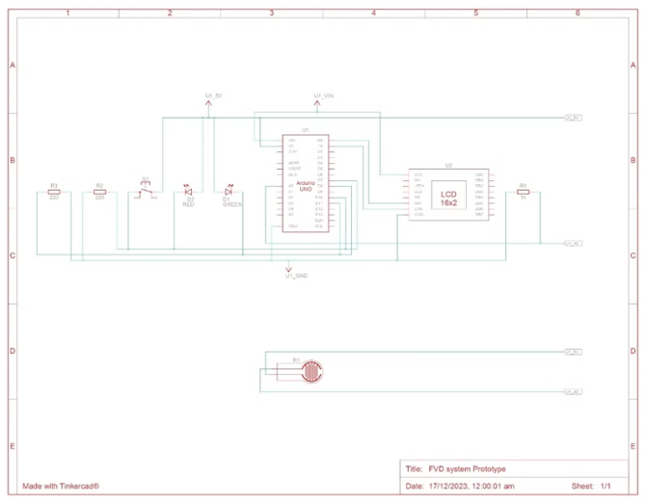
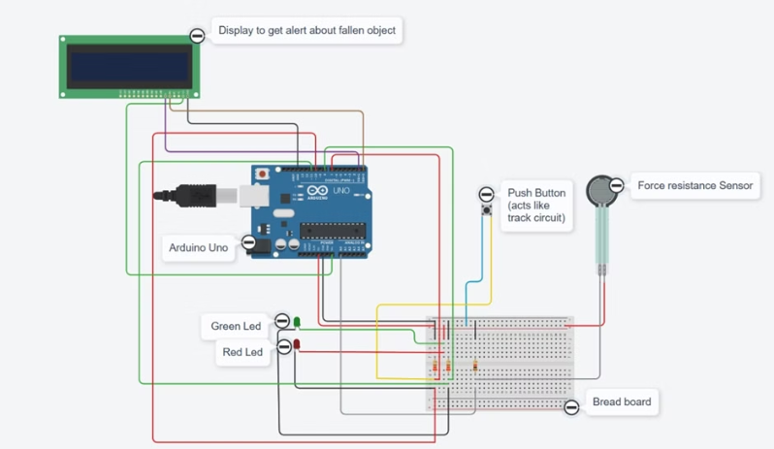
Circuit Design of FOD

Slide 16
Data Collection for Phase 2: Landslide Prediction System
For the limitation of acquiring physical data and the presence of structured good data over the internet, we endeavored to create synthesized data. We have utilized various features in our dataset, with landslides as the target class. The target class can take binary values, where 0 represents no possible landslide and 1 indicates the possibility of a landslide.
Features and their corresponding number of labels:
Aspect: 5 labels
NDWI (Normalized Difference Water Index): 5 labels
Curvature: 5 labels
Plan: 5 labels
Earthquake: 3 labels
Precipitation: 5 labels
Elevation: 5 labels
Profile: 5 labels
Flow: 5 labels
Slope: 5 labels
Lithology: 6 labels
Landslide: 2 labels
NDVI (Normalized Difference Vegetation Index): 5 labels
Each feature can take values ranging from 1 to the maximum value of the number of labels assigned to it. The dataset has been structured with these features to enable the development of a robust landslide prediction system.

Slide 17
Features
Aspect: Aspect represents the direction that the tangent plane passing through a point on the land surface faces, expressed in degrees.
NDVI: Normalized Difference Vegetation Index (NDVI) is a measure of vegetation density and health.
Earthquake: This feature represents the seismic activity in the area. seismic activity can induce landslides and can also be responsible for the scale with which it can affect.
NDWI: Normalized Difference Water Index (NDWI) is related to the plant water content and water stress.
Profile: Profile refers to the longitudinal topographic profile of a landslide daylight surface.
Elevation: Elevation refers to the height of the land surface above a reference point. Elevation is one of the most essential key factors that determine the stress distribution of slopes
Slope: Slope angle represents the steepness of the slope.

Slide 18
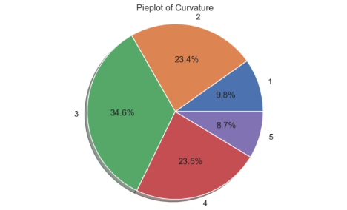
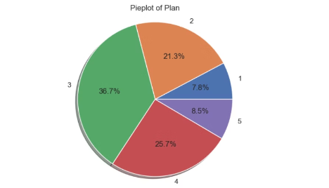
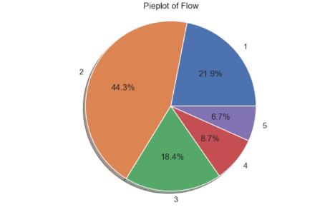
Features
Curvature
Plan
Flow
Profile curvature is the curvature in the downslope direction (aspect) along a line formed by the intersection of an imaginary vertical plane with the ground surface. Profile curvature affects the driving and resisting stresses within a landslide in the direction of motion.
Plan curvature is the curvature of a line formed by the intersection of an imaginary horizontal plane with the ground surface. Plan curvature controls the convergence or divergence of landslide material and water in the direction of landslide motion
Flows occur when the material, soil, and/or rock, behave more like a liquid or fluid. Flows include mudflows, debris flows or lahars superheated water that moves down an erupting volcano). Flows occur due to a large amount of water or ice present in the soil or material.

Slide 19
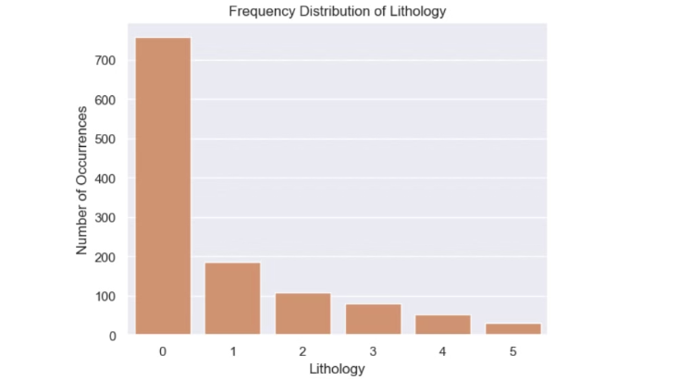
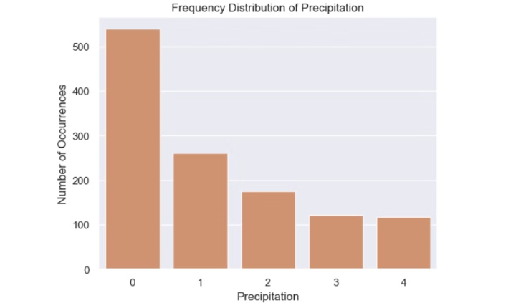
Features
Lithology
Precipitation
Lithology is the general characteristics of sediments, rocks and rock types present in a stratigraphic division of the earth. Several studies have concluded that lithology has a strong impact on spatial variation of landslide prevalence, type and depth
Rainfall is one of the most significant triggering factors for landslide occurrence. In general, the rainfall infiltration results in changing the suction and the moisture of soil, raising the unit weight of soil, and reducing the shear strength of soil in the colluvium of landslide

Slide 20
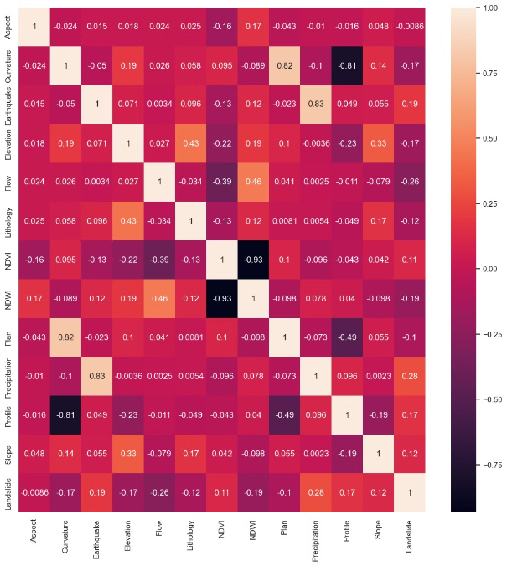
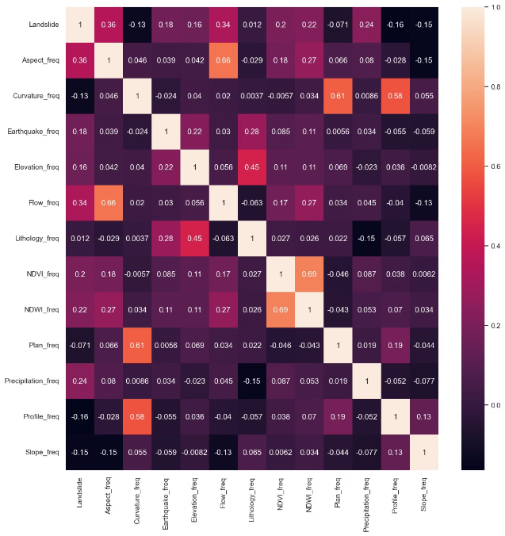
Feature Engineering

Slide 21
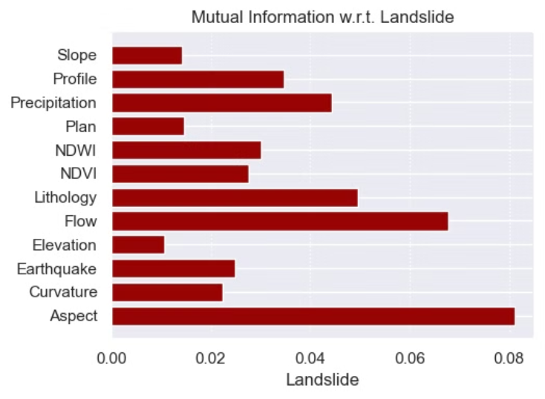
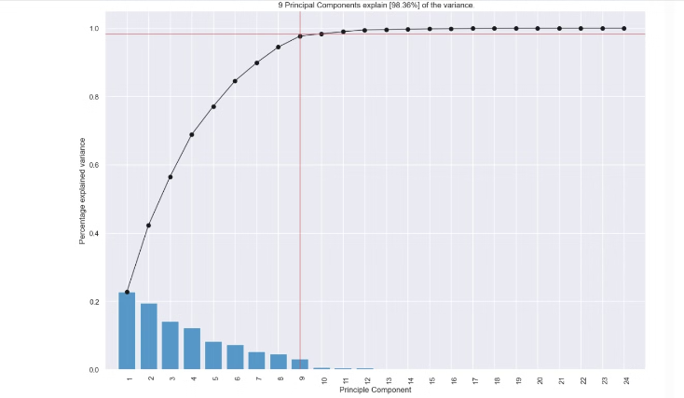

Slide 22
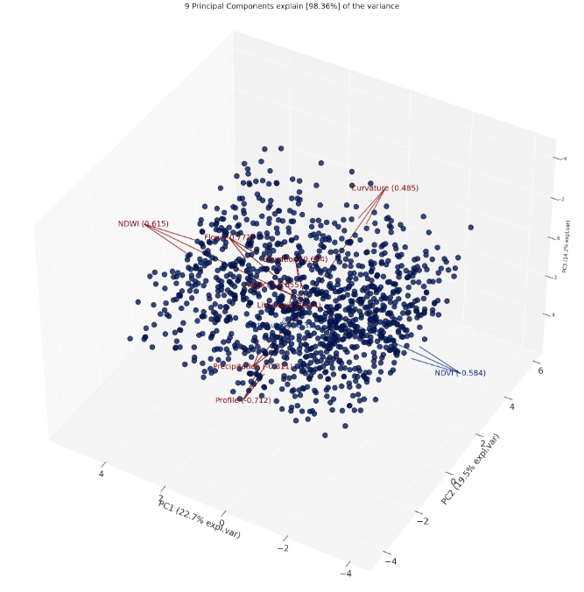
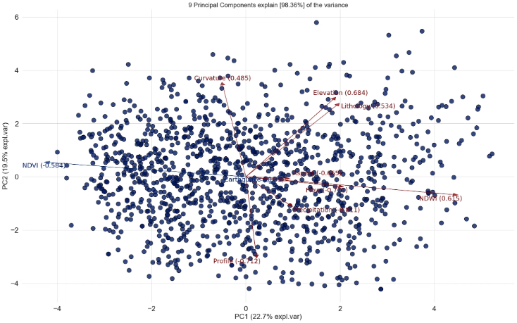

Slide 23
ML models used
Decision tree: A decision tree in machine learning is a hierarchical model used for classification and regression tasks. It organizes data into a tree-like structure, where each internal node represents a feature, each branch represents a decision based on that feature, and each leaf node represents the outcome. Decision trees are interpretable and can handle both numerical and categorical data, making them versatile tools for predictive modeling.
Handling mixed data types: Landslide prediction often involves a combination of numerical (e.g., rainfall, slope angle) and categorical (e.g., soil type, land cover) predictor variables. Decision trees can effectively handle both types of input features.
Capturing complex relationships: Landslides are typically caused by a combination of various factors, such as geology, topography, hydrology, and human activities. Decision trees can capture these complex, non-linear relationships between the predictor variables and the target landslide occurrence.
Providing interpretable models: Decision trees produce a set of interpretable rules that can be easily understood by domain experts, such as geologists and civil engineers. This can help in the analysis of the key factors contributing to landslide risk and facilitate the decision-making process.
Handling missing data: Real-world landslide datasets often have missing values, which can be a challenge for some modeling techniques. Decision trees have the capability to handle missing data by using techniques like surrogate splits.
Adaptability to new data: As new landslide events occur and more data becomes available, decision trees can be updated incrementally, allowing the model to adapt to changing conditions and improve its predictive performance over time.

Slide 24
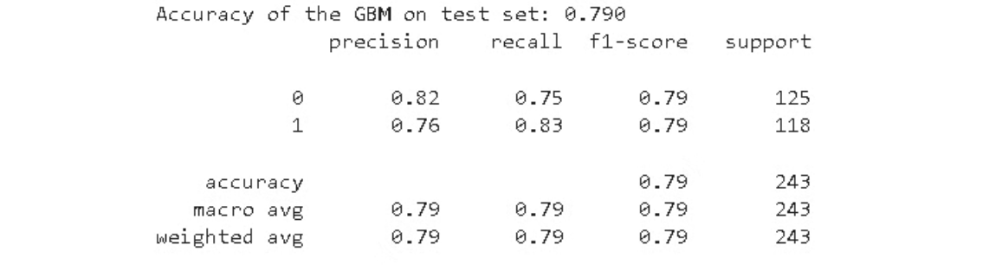
Gradient Boosting Machine (GBM)
Gradient Boosting Machine (GBM) is a machine learning algorithm that builds an ensemble of weak predictive models, typically decision trees, to create a strong predictive model.
Advantage in Landslide Prediction: GBM offers high flexibility and customization, allowing for the design of specific models tailored for landslide prediction tasks. It can effectively capture complex non-linear dependencies in data, making it suitable for predicting landslides based on various factors and interactions.

Slide 25

LightGBM:
LightGBM is a Gradient Boosting Decision Tree (GBDT) algorithm that incorporates Gradient-based One-Side Sampling (GOSS) and Exclusive Feature Bundling (EFB) techniques to enhance efficiency and scalability in machine learning tasks.
Advantages in Landslide Prediction:
LightGBM's optimization techniques can handle large datasets with high feature dimensions efficiently, making it suitable for processing extensive landslide prediction data.
By speeding up the training process significantly, LightGBM can quickly analyze and predict landslide occurrences, providing timely insights for risk assessment and mitigation strategies.
Despite the speed improvements, LightGBM maintains accuracy, ensuring reliable predictions for landslide events based on the data provided.

Slide 26
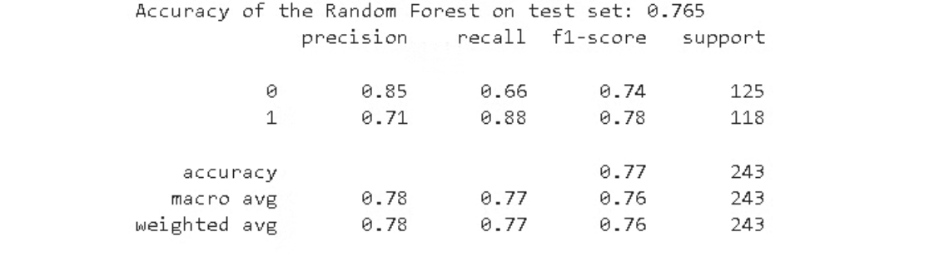
Random Forest
Random Forest in Landslide Prediction: Random Forest is a machine learning algorithm that combines multiple decision trees to make predictions.
Advantages of Random Forest in Landslide Prediction:
Random Forest is less prone to overfitting, making it suitable for handling complex and noisy landslide data.
t is less sensitive to outliers in the data, which is crucial when dealing with landslide prediction where outliers can skew results.
Random Forest eliminates the need for extensive parameter tuning, simplifying the model development process for landslide prediction.

Slide 27
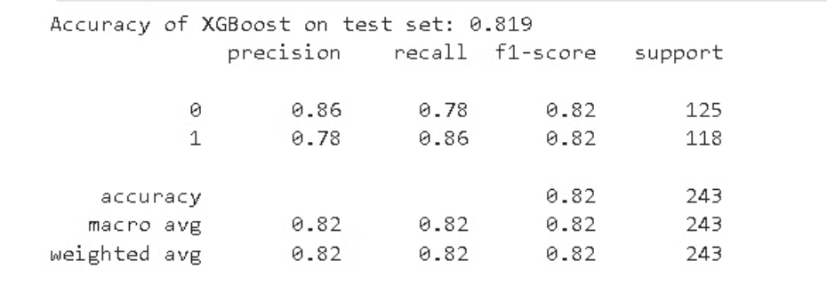
XGBoost
XGBoost is a scalable tree boosting system for machine learning that implements gradient boosting and incorporates sparsity-aware algorithms. It is widely recognized for its state-of-the-art results on various machine learning challenges. In landslide prediction, XGBoost's advantages lie in its scalability, speed, and ability to handle large datasets efficiently, making it a valuable tool for accurate and timely predictions in landslide risk assessment.

Slide 28
Results of the Comprehensive Railway Intelligent Safety System (CRISS) project:
Successful Object Detection:
Our prototype, utilizing Arduino and FSR sensors, effectively detects falling objects by measuring force.
Alerts are promptly sent using the GSM module, ensuring timely response in case of accidents.
Red aspect signals are activated to alert trains to potential hazards.
Landslide Prediction Accuracy:
The developed landslide prediction system, employing decision tree machine learning models, achieves an approximate accuracy of 81%.
This predictive capability enhances proactive safety measures along railway tracks.
Seamless Integration:
Both systems seamlessly integrate with existing rail track circuit/signal systems.
This integration ensures compatibility and enhances the overall safety infrastructure of railway networks.

Slide 29
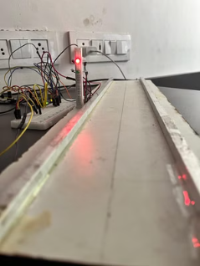
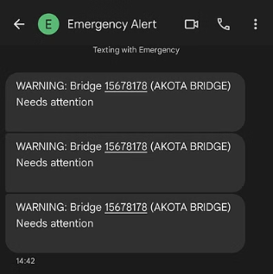


Slide 30
Discussions
The implications of our Comprehensive Railway Intelligent Safety System (CRISS) extend far beyond the prevention of individual accidents, signalling a paradigm shift in railway safety that can be exceptionally beneficial on multiple fronts. Even if our system averts a single major accident throughout its operational lifespan, the potential benefits are profound.
Saving Lives and Infrastructure
Operational Efficiency and Cost Savings
The primary and most critical advantage of our CRISS lies in its potential to save lives. The ability to detect and mitigate falling objects on railway bridges directly translates to a significant reduction in the risk of accidents and associated casualties.
Beyond the immediate safety implications, the FOD system has the potential to prevent delays in railway operations. By averting accidents and the subsequent need for emergency responses, the system ensures smoother rail operations, leading to cost savings and increased operational efficiency for railway authorities.
Furthermore, the prevention of structural damage to railway infrastructure adds an additional layer of value. By avoiding costly repairs and replacements, the CRIS system contributes to the preservation of railway assets.
Reduced delays also contribute to minimizing disruptions in the transportation network, benefiting passengers, freight, and the economy at large.

Slide 31
Discussions
Financial Impact on Railways
Addressing Human Intervention and Theft
The financial ramifications of railway accidents are significant. Our FOD system, by mitigating the occurrence of accidents, directly translates into cost savings for railway authorities. These savings can be strategically redirected toward further infrastructure development, maintenance, and safety enhancements.
In countries like India, where there is a heightened threat of mischievous human intervention and theft, the strategic design and implementation of the FOD system become paramount.
Incorporating security features and advanced algorithms to differentiate between genuine falling objects and intentional interference is crucial. This ensures the system's resilience against malicious activities, reinforcing its reliability in diverse operational environments.

Slide 32
Future Work
Utilization of Real Data
1
Transition from synthesized data to real railway data will provide valuable insights into the actual conditions and challenges faced in railway safety.
2
Investigation of Sensor Technology
Research into the type of materials used for wire fencing, the primary sensor for detecting falling objects, will be essential for maximizing detection accuracy and reliability.
Incorporation of new features relevant to railway infrastructure, such as track conditions, maintenance history, and environmental factors, will improve the accuracy and reliability of the safety system.
Exploration of different designs for wire fencing nets can enhance the effectiveness of the detection system, considering factors such as durability, visibility, and ease of installation and maintenance.
Analysis of real data may reveal previously unforeseen issues or patterns, allowing for further refinement and optimization of the detection and prediction models.

Slide 33
Future Work
Expansion of Safety Features
1
As the CRISS project aims to comprehensively address railway safety, future efforts will focus on exploring additional safety features related to foreign objects interfering with rail tracks.
2
Collaboration and Partnerships
Collaboration with railway authorities, industry partners, and academic institutions will be crucial for accessing real-world data, conducting field tests, and validating the effectiveness of the safety system.
This may include the development of advanced detection and prevention mechanisms for other types of foreign objects, such as debris, animals, or unauthorized access.
Partnerships with technology providers and research organizations can facilitate the integration of cutting-edge sensor technologies and data analytics techniques into the CRISS project.

Slide 34
Special Mentioning: ICFOSS
We extend our heartfelt gratitude to ICFOSS, the International Centre for Free and Open Source Software, an autonomous organization established by the Government of Kerala, India. ICFOSS plays a pivotal role in popularizing Free and Open Source Software globally, consolidating previous FOSS initiatives in Kerala, and fostering collaboration with various nations, communities, and governments to advance the cause of FOSS.
Our project had the privilege of seeking external mentorship from ICFOSS. After presenting our project idea, their esteemed panel selected our project for mentorship. Additionally, we had the honor of visiting the ICFOSS center during the project period.

Slide 35
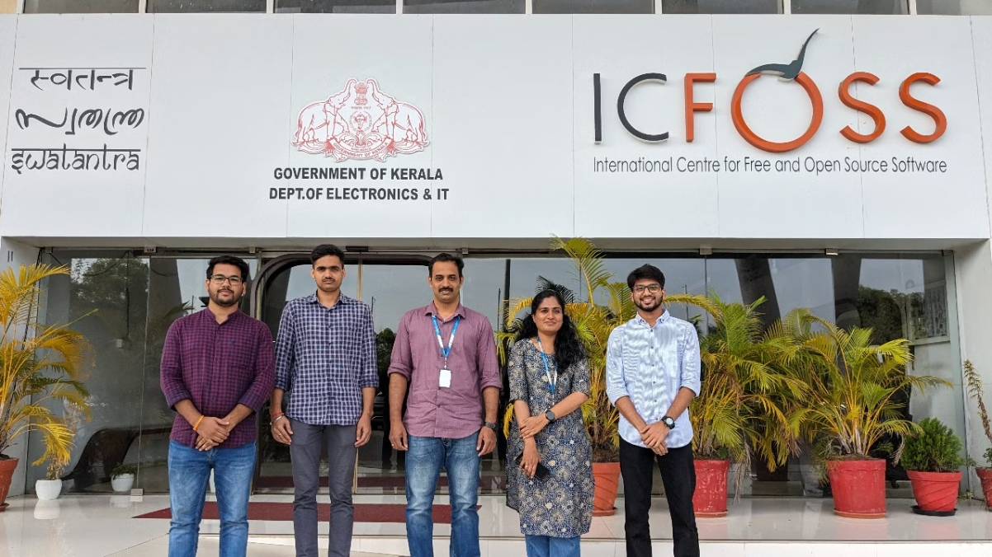
Special Mentioning: ICFOSS
We express our sincere appreciation to Gopika Ma'am and Sajil CK Sir for their invaluable guidance and support throughout our journey. Their mentorship has been instrumental in the success of our project.

Slide 36



Mentor Appreciation
Dr. Bharat Bhushan Sharma
O P Kesari
Aditi Gupta
Assistant Professor, GSV
Former Executive Director, RDSO
Graduate Engineer, Atkins

Slide 37



Team Members
Mayank Pandey
Saswat S Mohanty
Sudhanshu Kumar
2080034
2080049
2080054

Slide 38

Thank You

